Slide 1

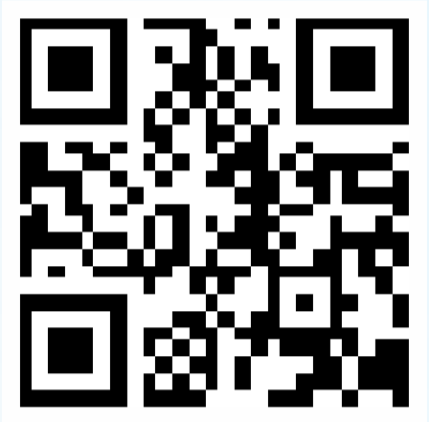
KUSHAL METAL & STEEL INDUSTRIES
Welcome
Scan me

Slide 2
Introduction
  Kushal Metal & Steel Industries is a steel trading & stock holding company dealing in all kinds of high speed steel, cold work steel, hot work steel, plastic mould steel, beryllium copper, cutting tools & more.
  Our Sole aim to is to serve to serve the tool room with quality tool steel at reasonable price.
  We are committed to establish the name of Kushal Metal & Steel Industries as an organization of trust providing quality tool steel with timely delivery & quality service.

Slide 3




History
2000
2012
1968
-10000 Sq ft warehouse bought in Kalamboli
-Partnered with NGK Japan for 2% Beryllium Copper
Warehouse in Darukhana-6000sq ft
Started two warehouses of 12000 sqft each
Introduced Villares & Sanyo tool steels
-New Branch in Ahmedabad
-Mr. Avantilal Doshi established
Dinesh Hardware Mart in 350 sqft warehouse in Khumbharwada to trade tool & alloy steels
2004
2015
2008
2016
1979
2011
-Partnered with DSS, Nippon, SSAB(Toolox)
-Opened a elegant new office in South Mumbai
Upcoming warehouse in Bangalore & bigger warehouse in Mumbai
-Mr. Nitin Doshi joined the business
-New Ware house of 550 sqft in Mumbai
Kushal Metal & Steel Industry Established
-Mr. Kushal Doshi joins business
-12K Sqft Warehouse in Bhiwandi
-KMSI signs JV with TG & forms TGK Special Steel to make HSS, die steel, Titanium, HSS & Carbide Cutting Tools
2018/19
1980
1980
2012
2020
1988
Notes:
© Copyright PresentationGO.com – The free PowerPoint and Google Slides template library

Slide 4


Mission & Vision
Our main aim is to provide quality tool steel for manufacturing units/tool rooms across India
Provide service & material to take our clients into a non inventory module
Being the first choice for our customers
Innovate and provide Best Steel Grades from reputed manufacturers around world
Open up branches across India
Contribute to India’s Growth
Provide value added services – material machining, cut pieces & tailor made material

Slide 5
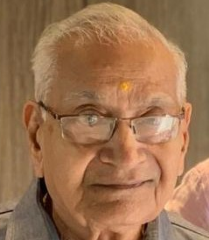
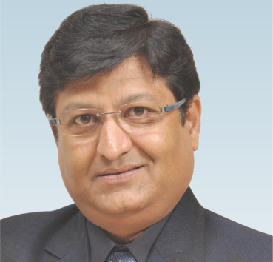
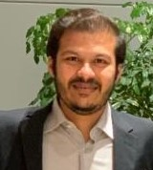
3 Generations of Visionaries
Avantilal Doshi
Nitin Doshi
Kushal Doshi
Founder
Visionary
Strategist
Founded Dinesh Hardware Mart and started wholesale trading in Tool and Alloy Steel in 1967
-Joined the Business in 1979 after finishing his 11th grade.
-His sharp acumen and vision has propelled Kushal Metal in the right trajectory
-Joined the business in 2011 after finishing his Masters in Business & Accounts in the UK
-Built the company reputation by providing quality service, timely delivery & high volume.
Notes:
© Copyright PresentationGO.com – The free PowerPoint template library

Slide 6

Our Locations
Mumbai
-Head Office 2200 sq ft at Majestic Shopping center at Opera House(South Mumbai)
-2 Warehouses of 24000 sqft in Bhiwandi with ---1 ware house of 6000 sq ft in Darukhana with 2000 sqft office
Ahmedabad
-3000 sqft ware house
Notes:
© Copyright PresentationGo.com – The free PowerPoint template library

Slide 7
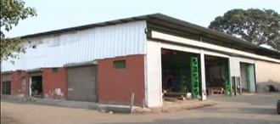
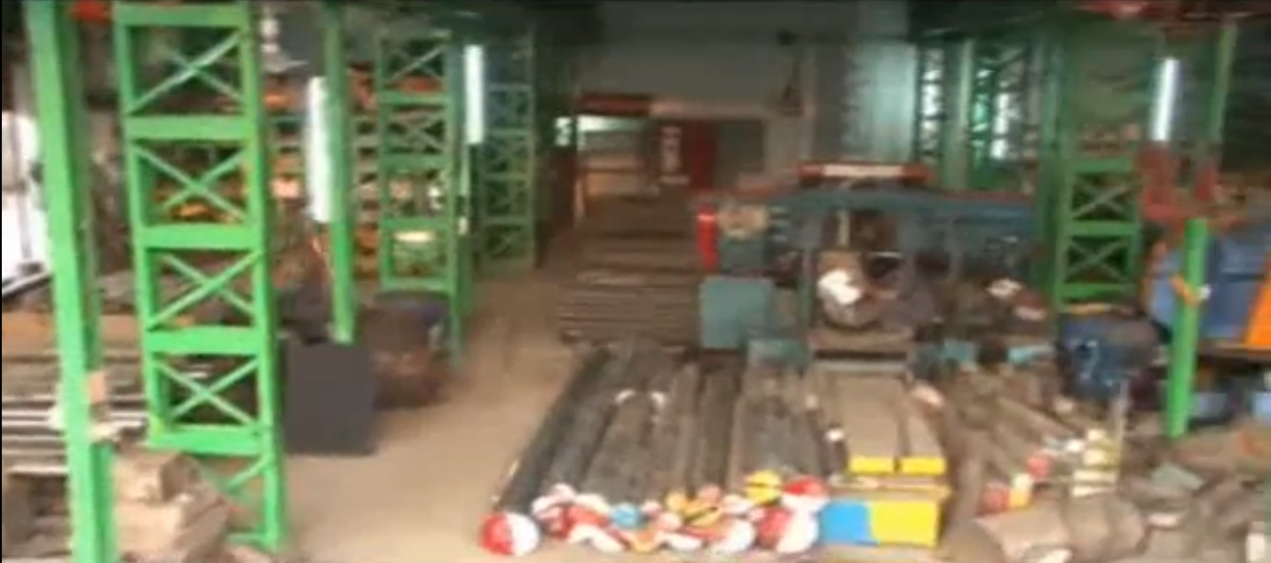
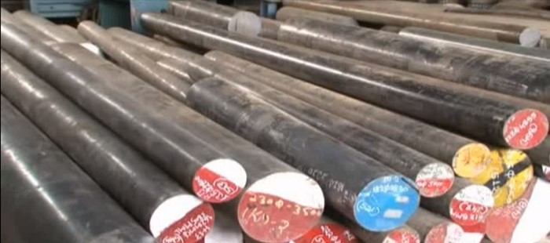
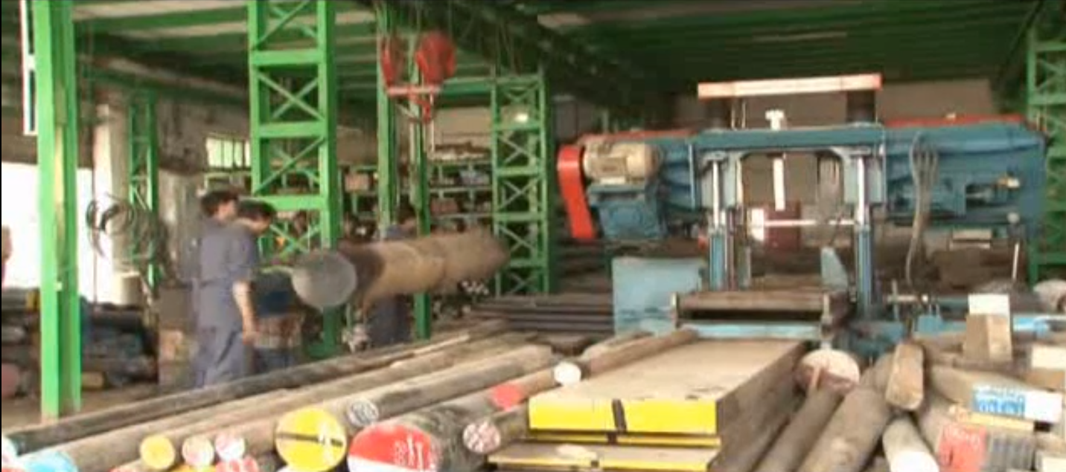
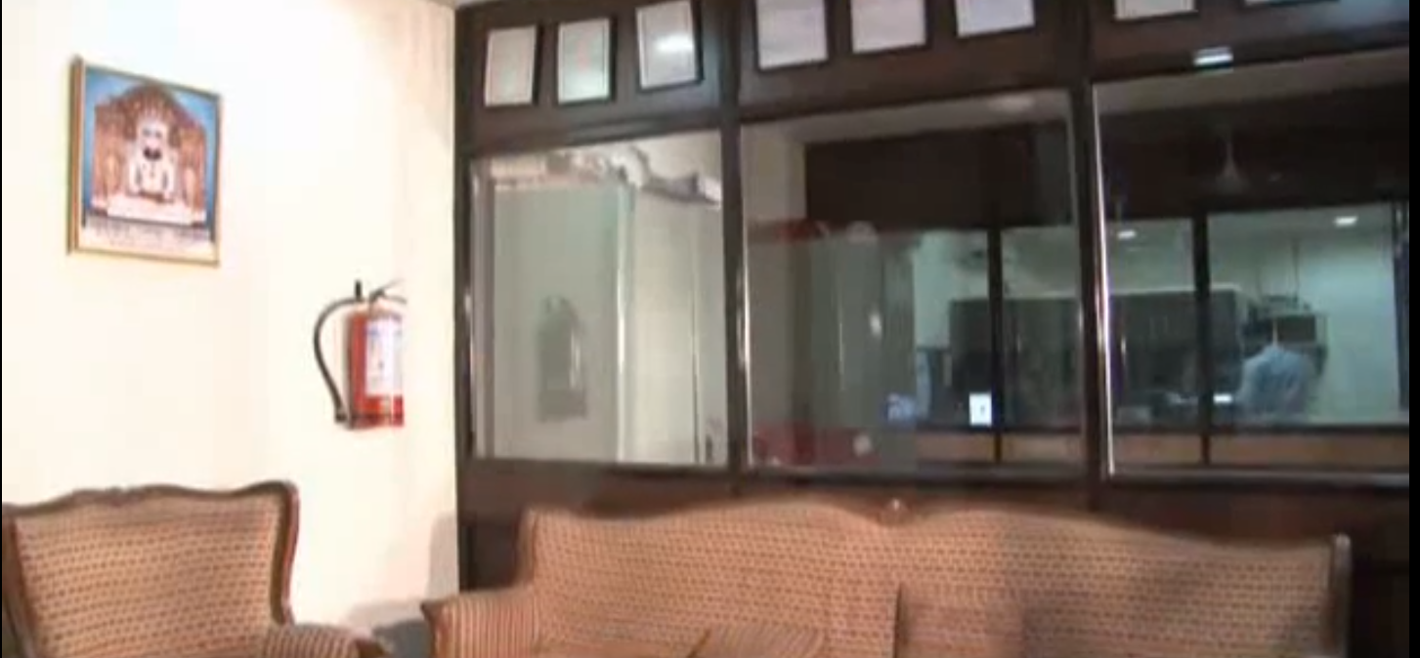
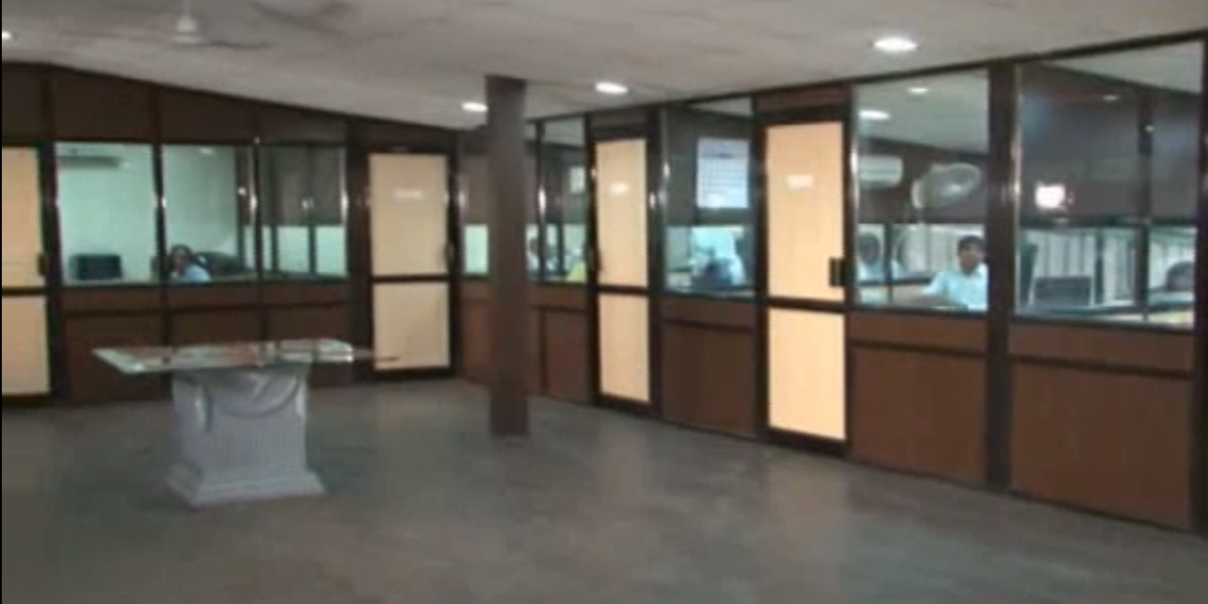
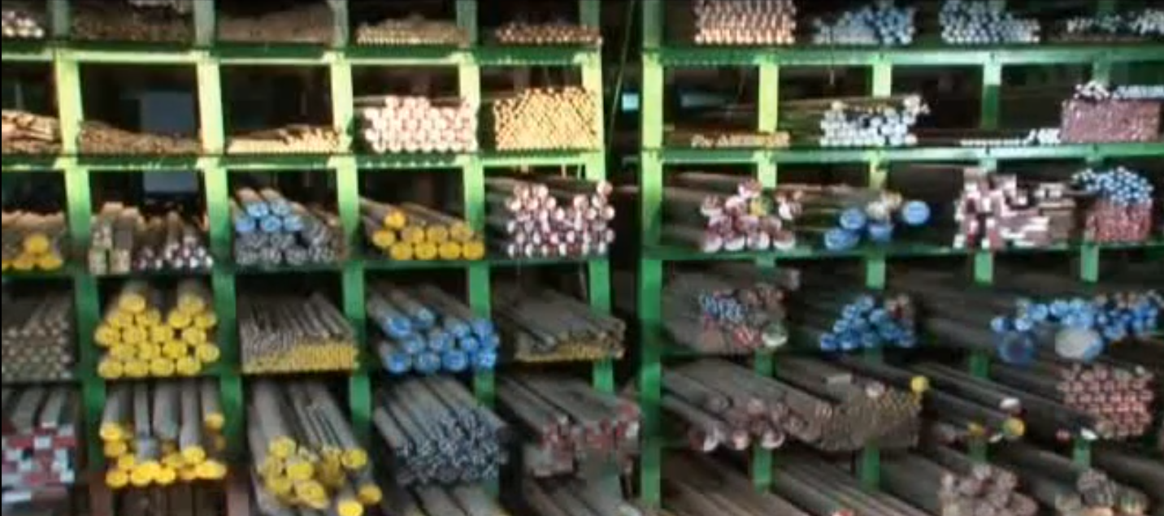
KUSHAL METAL (DARUKHANA)
Darukhana
6000 sqft warehouse
2000 sqft office Area
3 Rail Crane Lifts
2 Band saw Machine

Slide 8
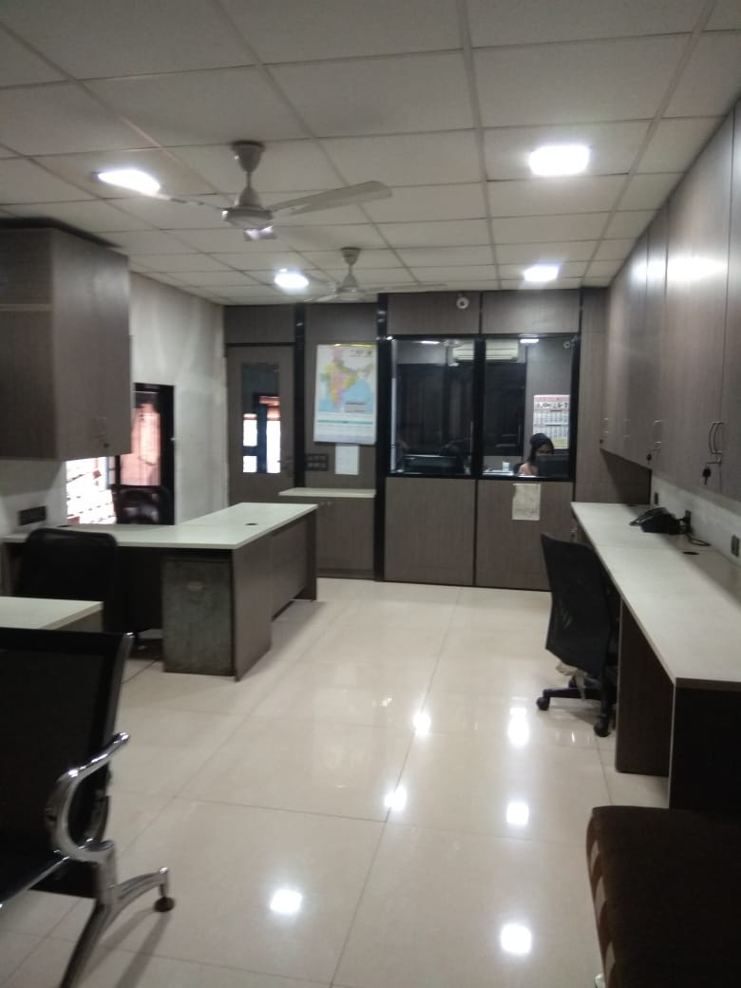
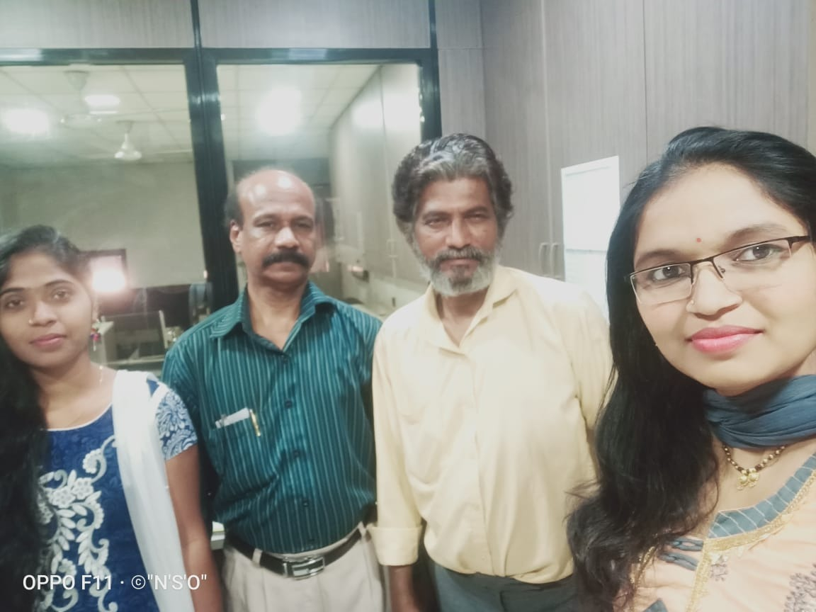
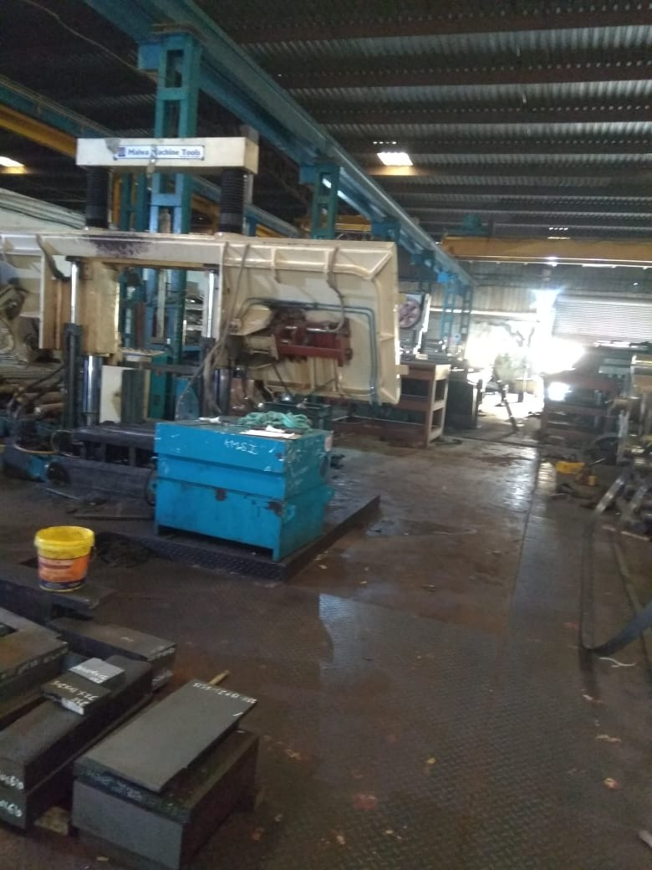
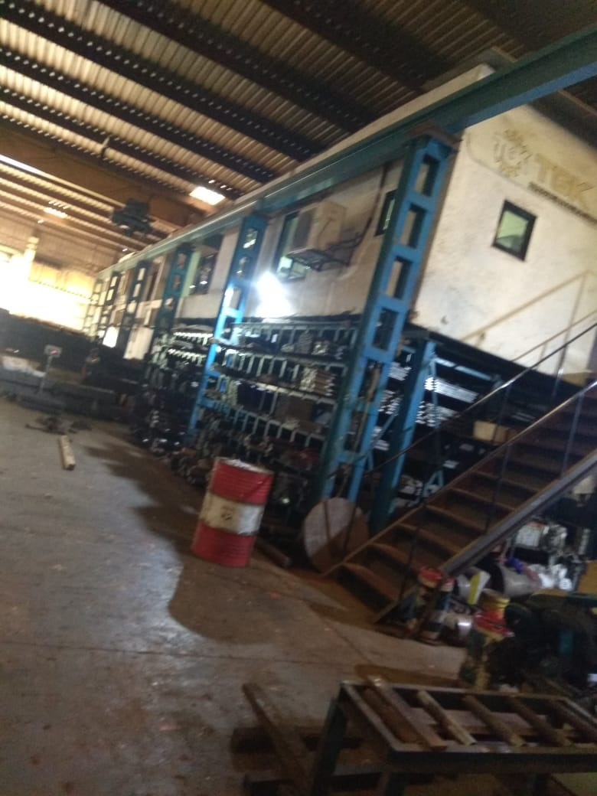
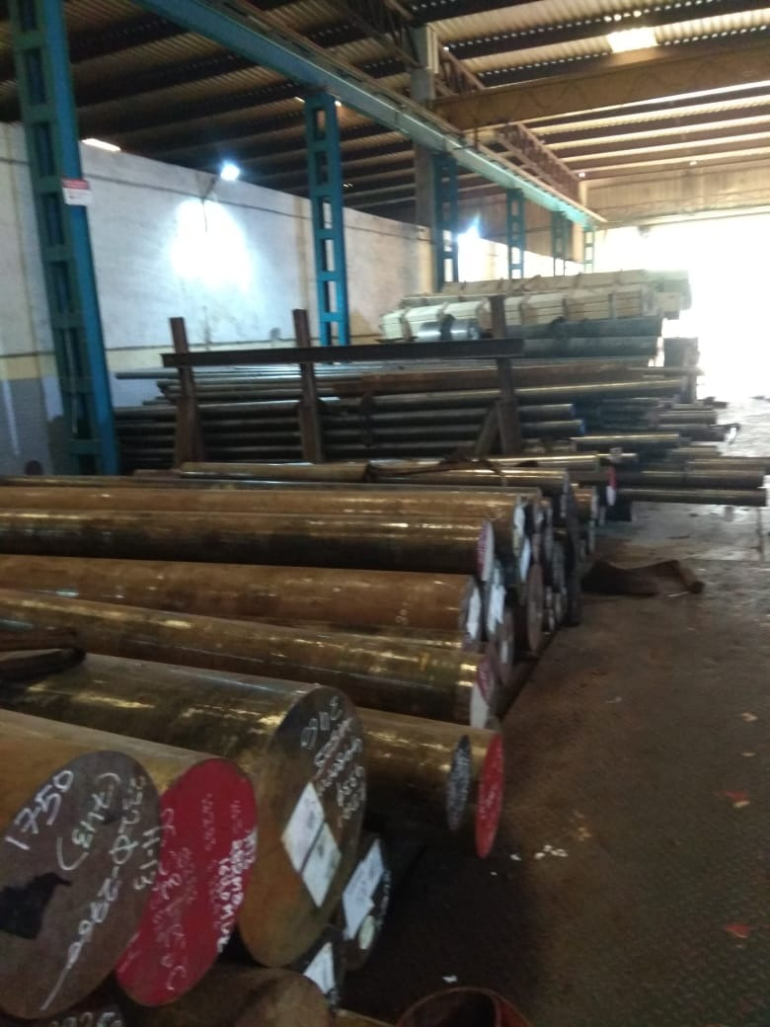
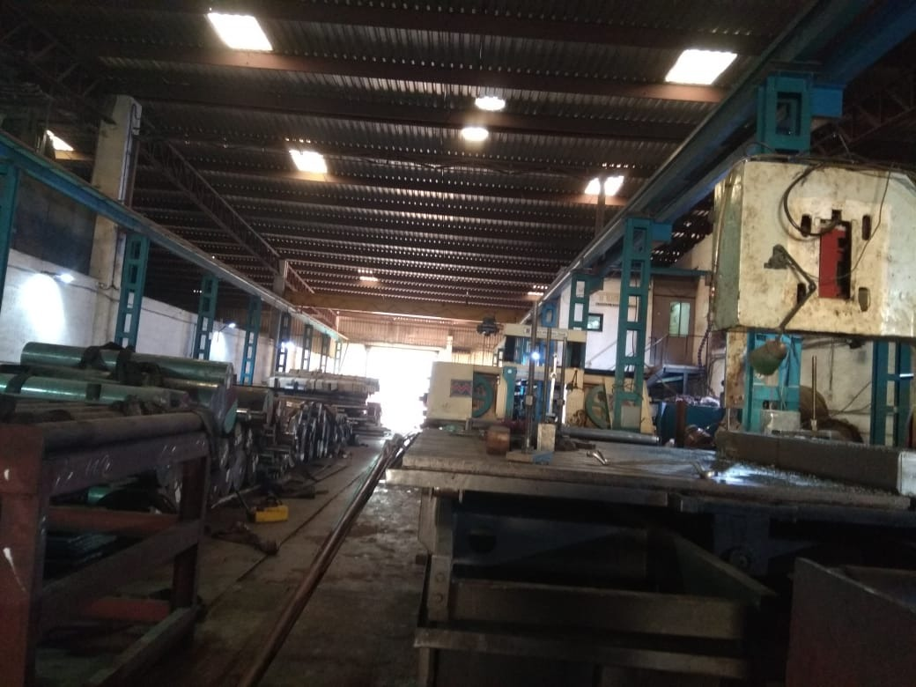
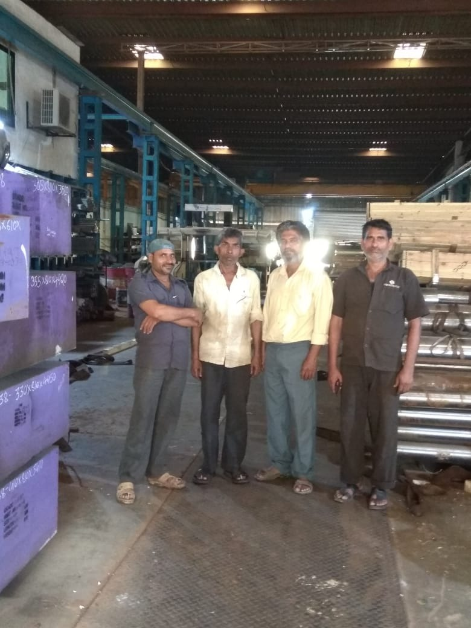
KUSHAL METAL (BHIWANDI)
Bhiwandi
12000 sqft Warehouse
1000 sqft Office Area
3 Rail Crane Lifts
2 Bandsaw Machine

Slide 9
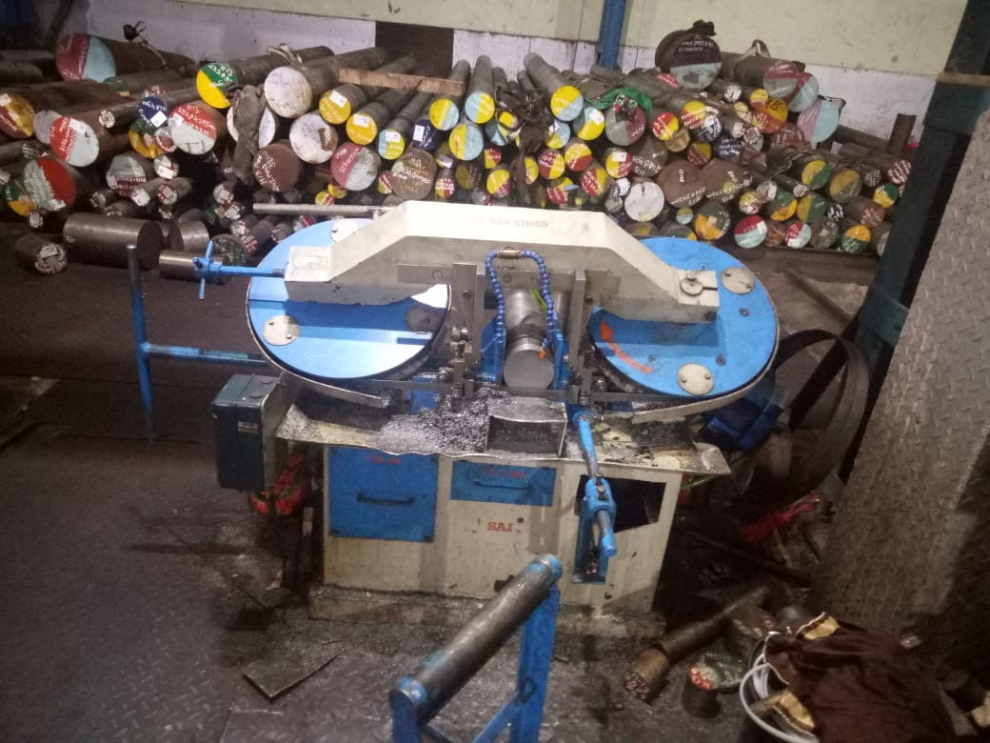
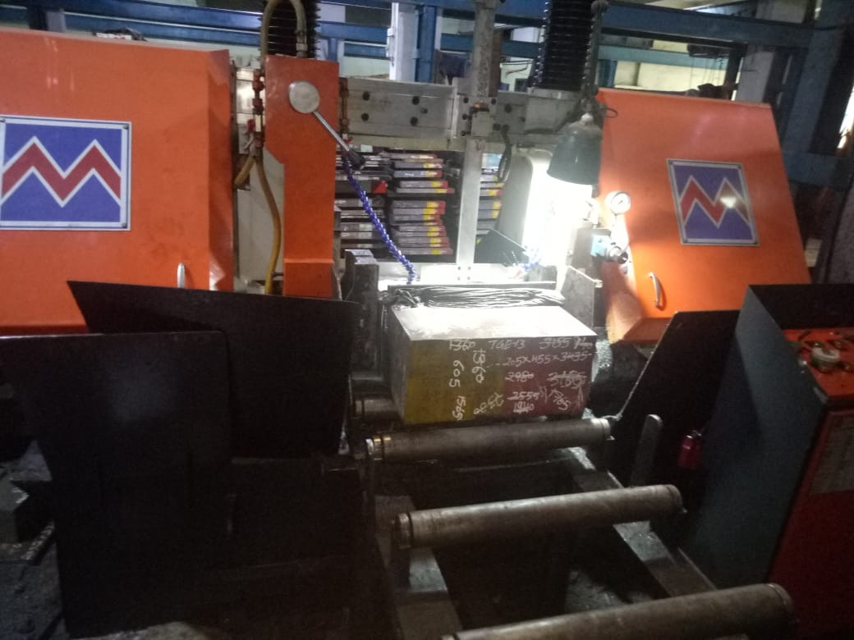
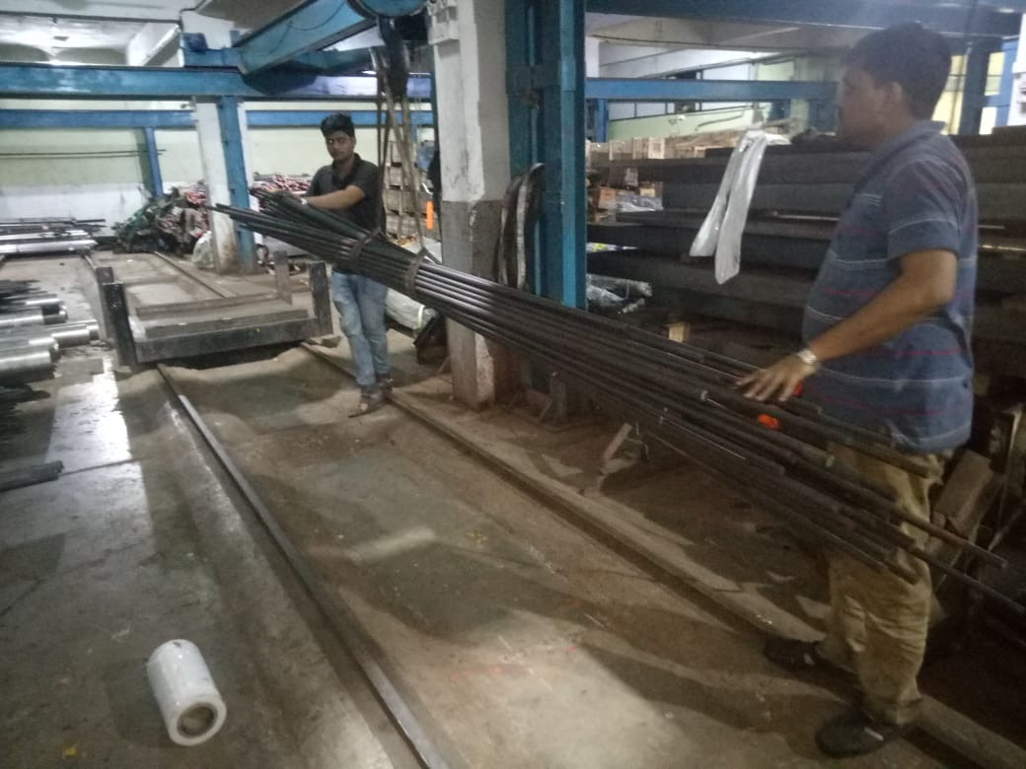
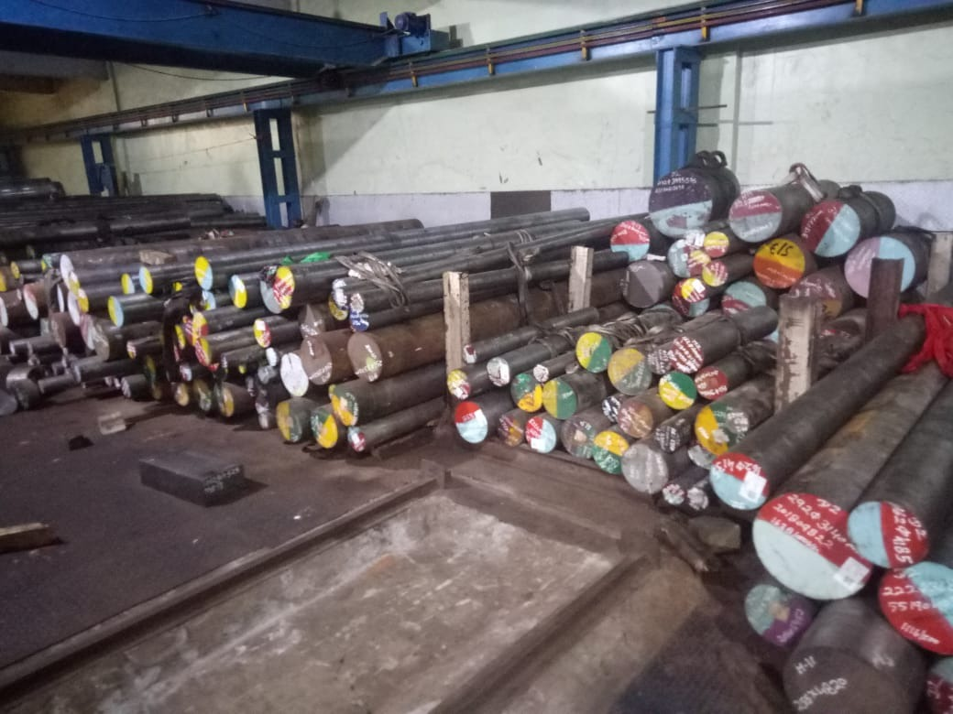
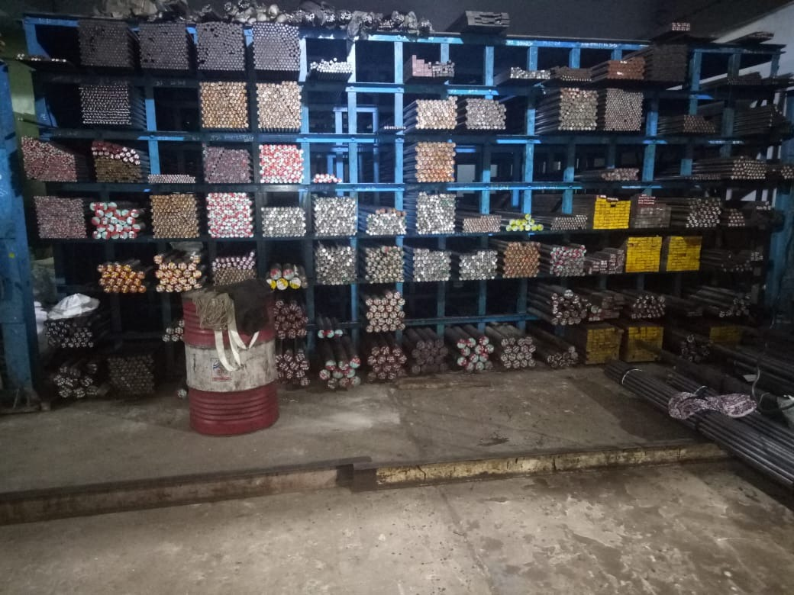
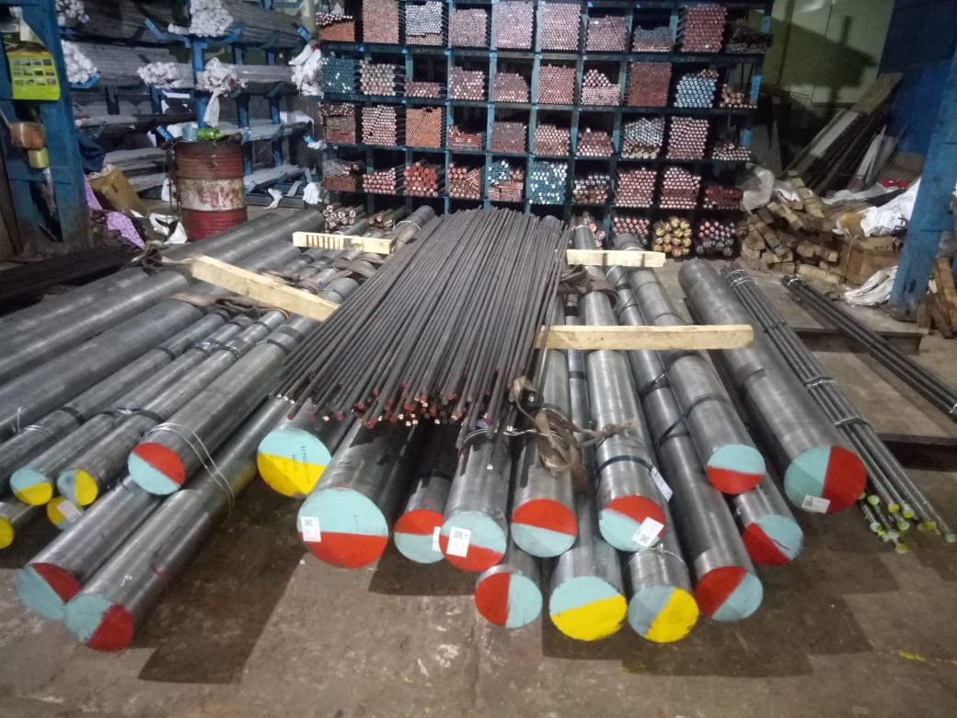
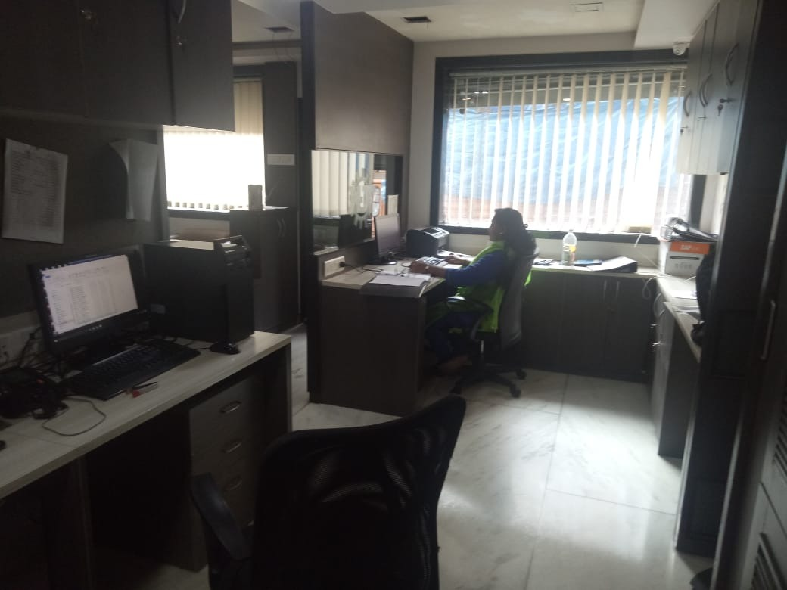
TGK SPECIAL STEEL
Bhiwandi
12,000 sqft warehouse
1000 sqft office area
3 rail crane lifts
2 band saw machine

Slide 10
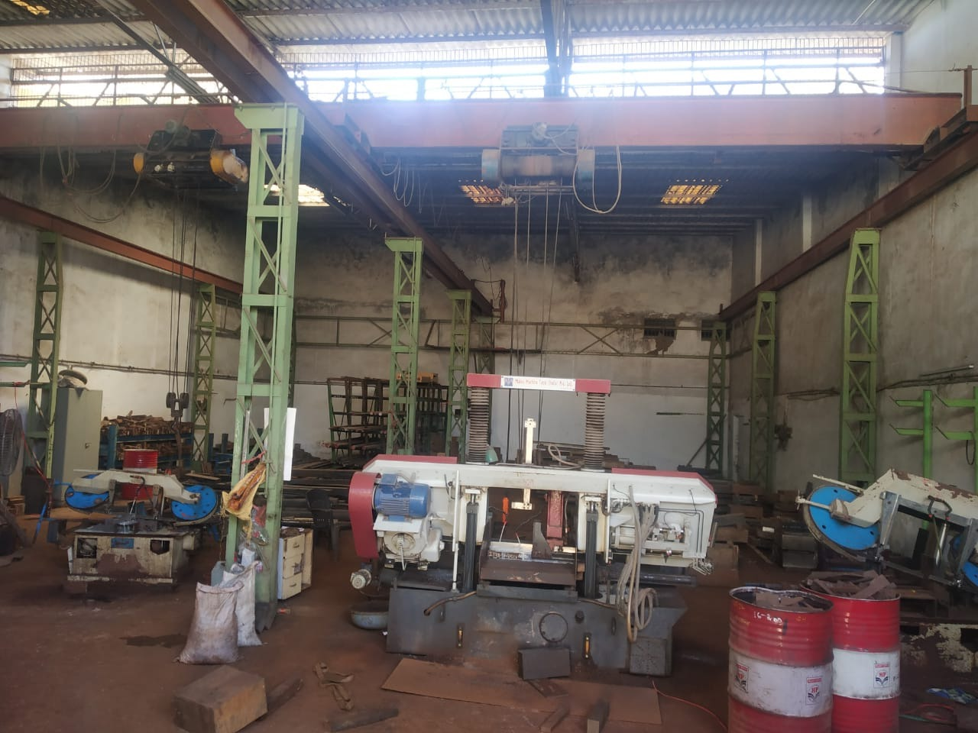
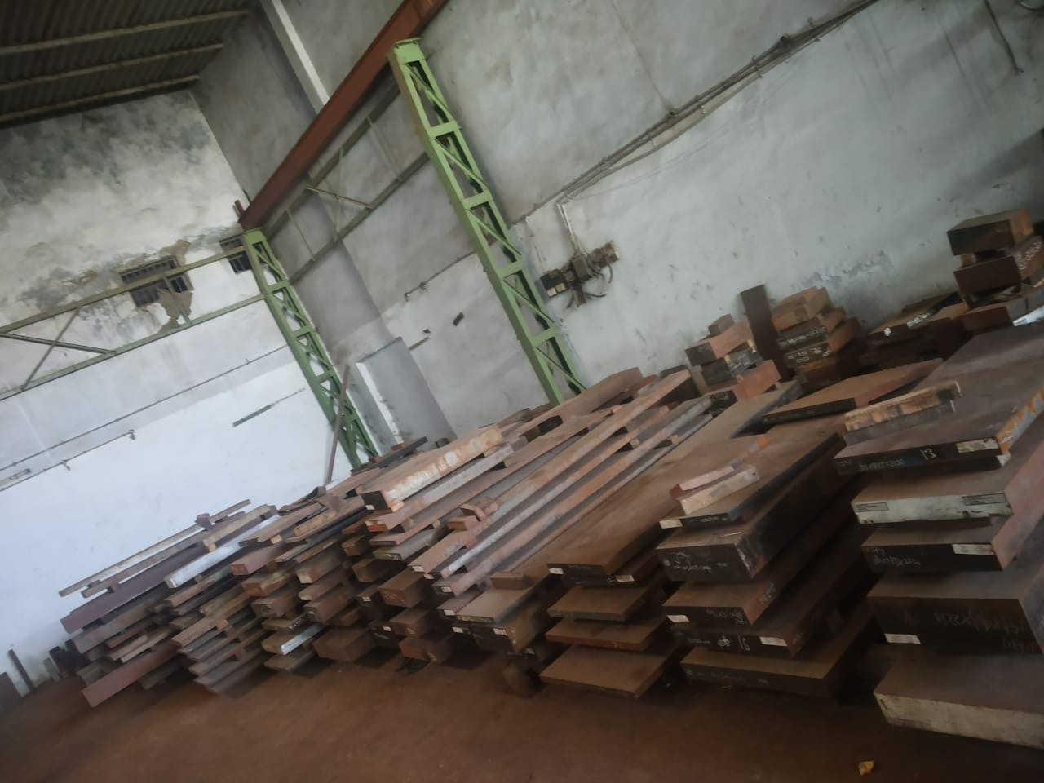
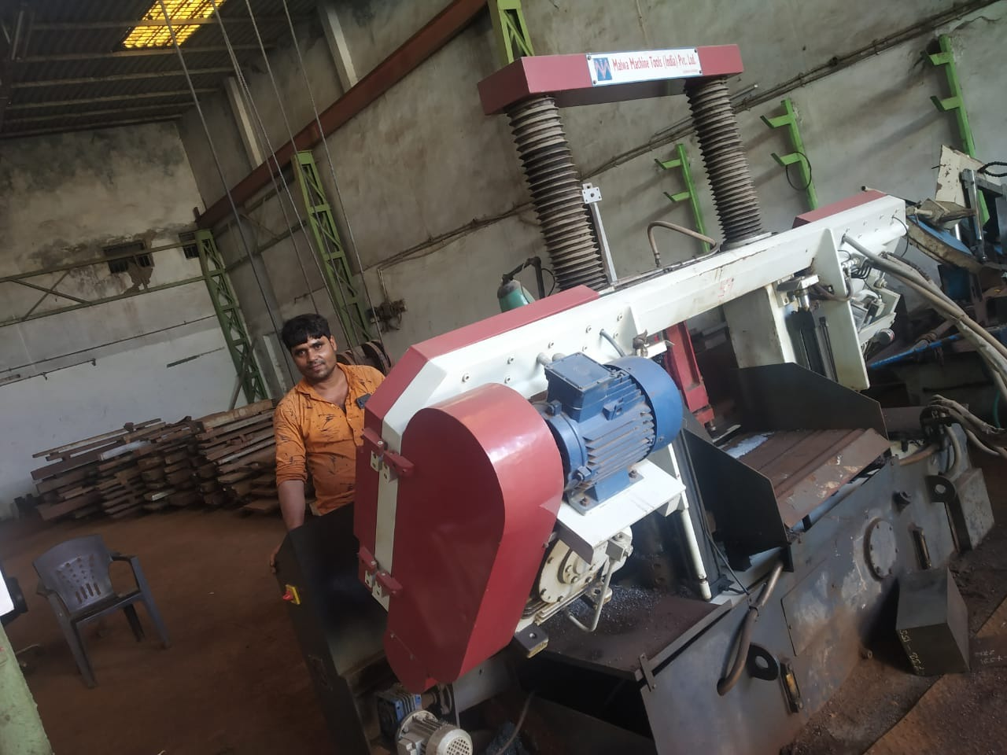
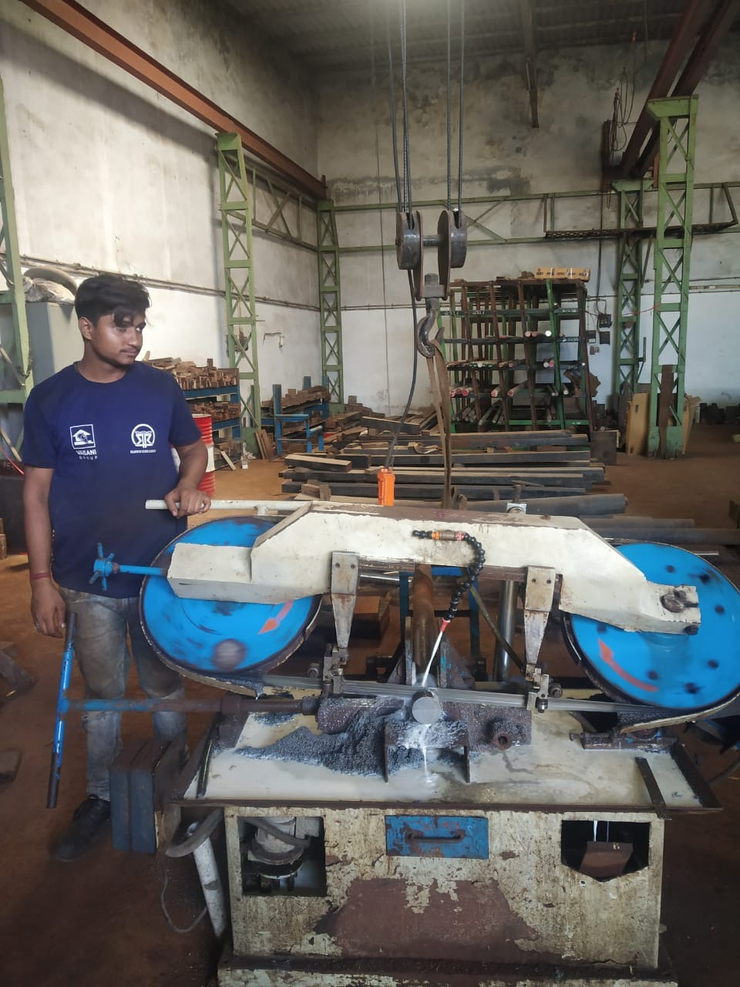
KUSHAL METAL (AHMEDABAD)
Ahmedabad
3000 sqft Warehouse
1000 sqft Office Area
2 rail crane lifts
3 band saw machine

Slide 11
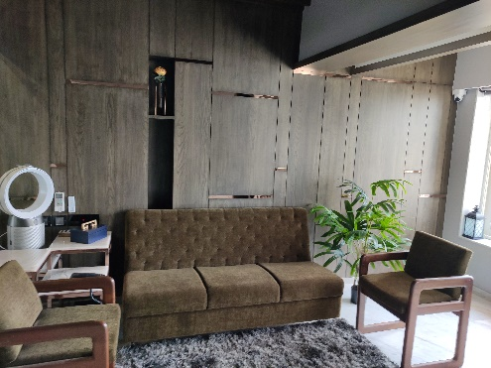
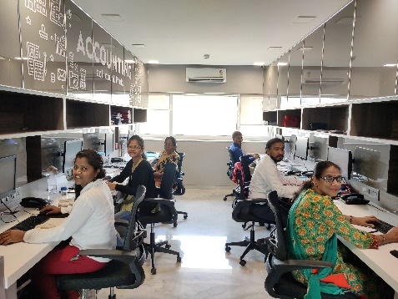
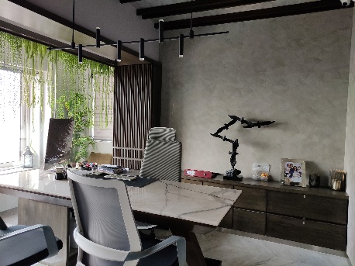
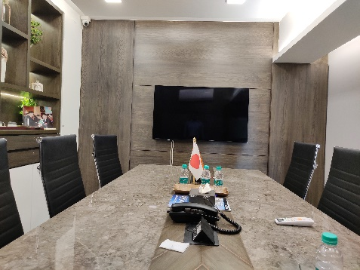
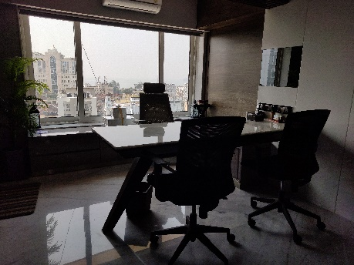
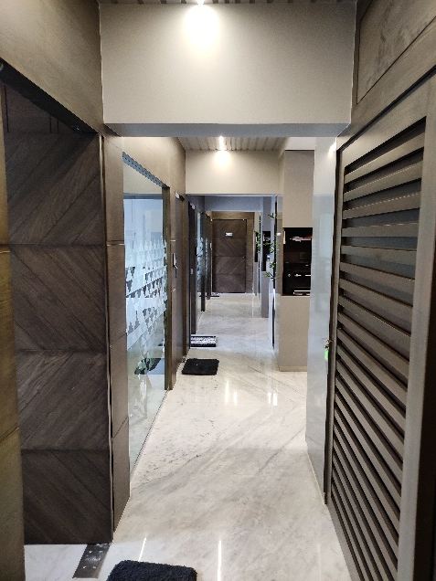
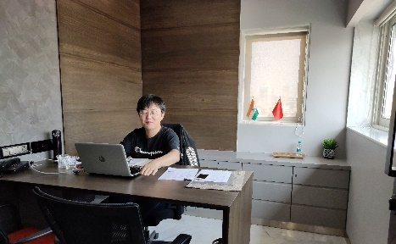
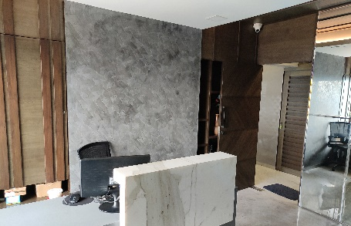
HEAD OFFICE
South Mumbai
2,200 sqft office
26 Employees

Slide 12
PRODUCTS WE DEAL IN
Hot Work Steel
H-11 & H11M
TGE-13
H-13 & H13M
TGE-23
TGGP-13
Cold Work Steel
D-2
Plastic Mould
D-3
DC-53
S-7
1.2738
1.2311
1.2714
1.2510
Others
HSS & Carbide Cutting Tools
EC Cu
1.2316
O-1
High Speed Steel
M-2
TGM-2A
TGM-2B
M-35
M-35A
M42
Titanium & Ti Alloys
KDA1
KDA1S
KDAMax
KD 21
KD 11 Max
Toolox
Toolox 33
Toolox 40
Toolox 44
Corrosion Resistant Steel
440B
440C
1.2083
1.2085
NAK 80
2% Be Cu
A2
PHX Supra
SPM 30
SPM 50
SPM 60
Rods
Blocks
Square
Sheets
Coils
Flats

Slide 13
Sizes
Type | Size | Delivery condition
Coils | φ1.0-φ22mm | Cold Drawn
Rounds | φ1.0-φ14.4mm | Cold Drawn/Center less ground
Rounds Hot Rolled | φ14.5-φ80.0mm | Hot Rolled, Annealed, Peeled
Rounds-Forged Bars | φ81.0-φ810.0mm | Forged, Annealed, Turned
Small flat bar/square bar | (3-40)Χ(10-150)mm | Sand Blasted
Flat Bars-Hot Rolled | (12-120)Χ(150-810) mm | Sand Blasted
Sheets-Hot-rolled | (3-10)Χ(410-1000) mm | Black
Sheets-Cold-rolled | (0.5-5)Χ(410-1000)mm | Grey
Block | (100-550)Χ(200-1200)mm | Black/Machined

Slide 14
NGK INSULATORS LTD & Kushal
Rods
Tubes
Plates

Slide 15
INDUSTRIES SERVED
Jigs & Fixtures
Aluminium Extrusions
Plastic Manufacturing
HSS Cutting Tools
Die Casting
Punches
Tablets/Pharma
Press Tools
Fasteners
Hobbs & Broaches
Ejector Core Pins
Thread Rolling
Industrial Knives & Blade

Slide 16
Our Growth

Slide 17







Our Global Partners

Slide 18
Road map
New branches
1
Start branches in Delhi, Ludhiana & More
3
New warehouse
New ware house near Mumbai with an area of 50,000-80,000 sqft
Hi-tech Equipment
2
Bring in new hi-tech band saws, milling machine, grinding machines for raw material.
Notes:
© Copyright PresentationGO.com – The free PowerPoint template library

Slide 19
Stay in Touch with us
Head Office
8th Floor, Majestic Shopping Centre Premises Co
Op Society Ltd, 144 JSS Road, Girgaon, Mumbai-400004
Tel: 02268520000-30
Unit I
Plot No-13-A, Gala No-3/4/5, Oza Market & Ware House,
Magazine Street, Near Devidayal Compound, Darukhana, Reay Road [E], Mumbai-400 010.
Unit 2
Gala No. 3/4/5/6, Bldg. No. 158/B,
Indian Corporation Compound, Mouje Gundavli (Mankholi - Phata), Taluka: Bhiwandi - 421 302.
Tel: 02522-661950
Unit 3
Shed No 44, Ghanshyam Estate,
Near Murga Farm Rd, Virat Nagar Char Rasta, Bapunagar, Ahmadabad – 380024.
Contact : Keval Shah - +91 9224640506
Contacts
Proprietor: Mr Nitin Doshi
Cell:+919322233268
Email: kushal@kushalmetal.net
kushalmetal09@gmail.com
Mr Kushal Doshi
Cell:+919920475123
Email: kushal@kushalmetal.net
Mr Maunish Shah
Cell:+919920475123
Email:maunish22@gmail.com

